Slide 1

Common Ground
How to use street engagement to: ​
Nudge
Educate
Recruit
Mobilise

Slide 2
Our Message
“The billionaires and their media are using hate and fear to divide communities and win power. We believe there's more that unites than divides us and we're having the conversations that prove it.”
What we say on the street:​
We’re a group of women, as it happens, from no political party, anxious about the direction of travel in politics and society as a whole and keen to find out how people feel on key issues.
We aim to counter the Reform UK/Conservative agenda… and the​
racist, xenophobic and often misogynist narrative spread by toxic media and attempt to give prominence to shared values of decency, tolerance, compassion and fairness.

Slide 3
Democracy Meters
The democracy meter is our tool of engagement. Everybody loves stickers!​
Of course, the questions simplify the issues. They are designed to provoke a conversation.​ Sometimes, just explaining what the question means gives us a chance to gently educate and nudge​.
Our questions have evolved as we discover what works and what doesn’t.​ Sometimes we are focused on a theme, as in
an outing to Plymouth in support of Indivisible, for example.

Slide 4
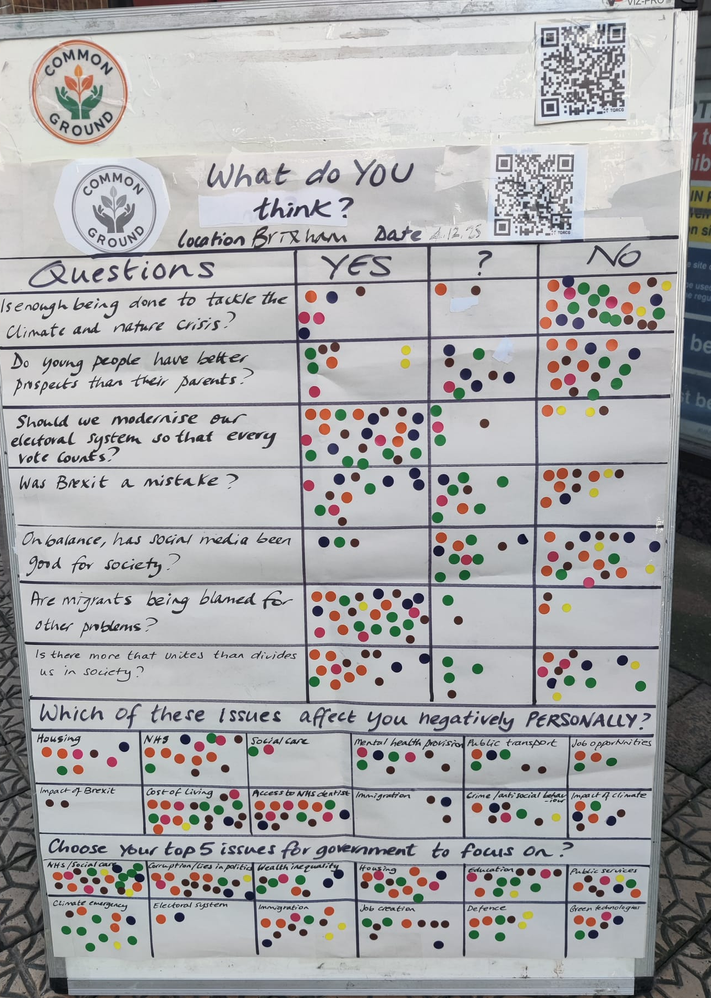
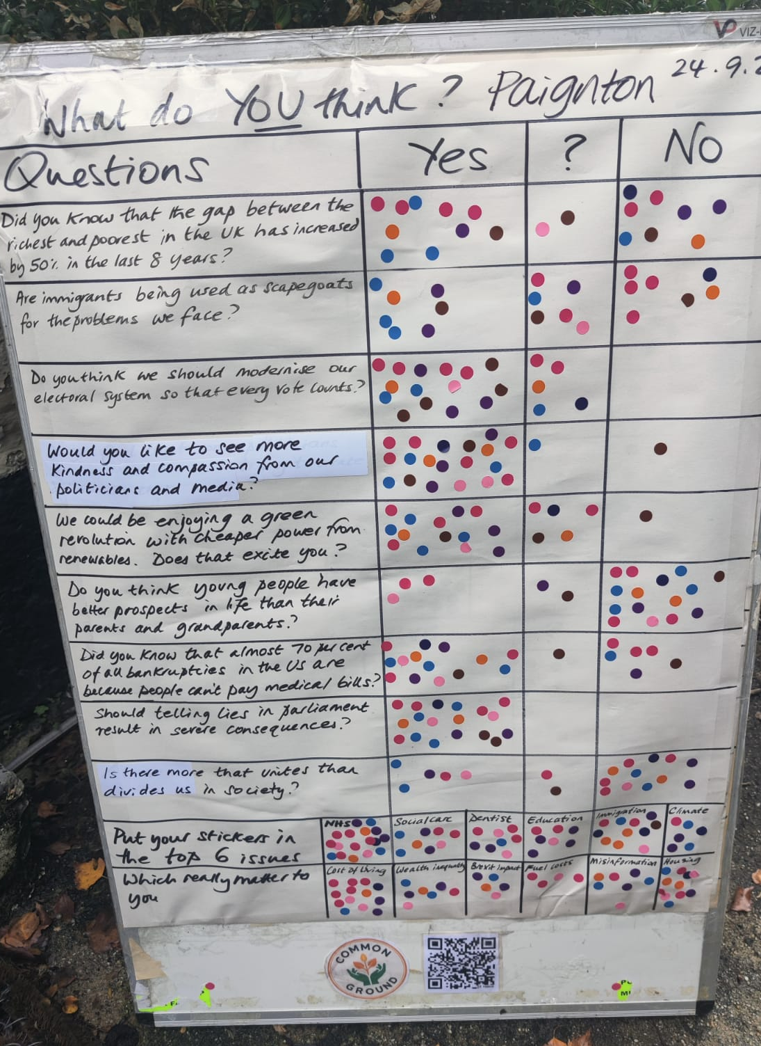
Our Regular Board…

Slide 5
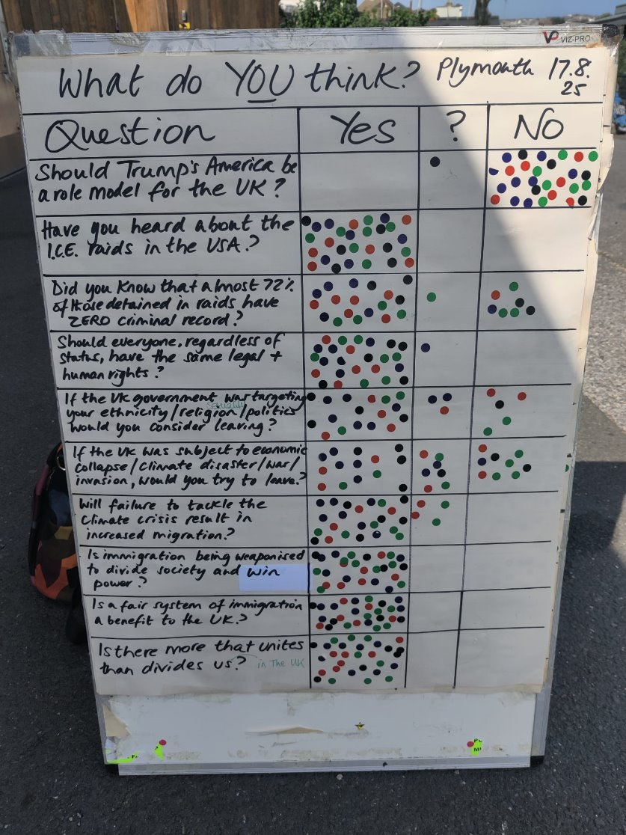
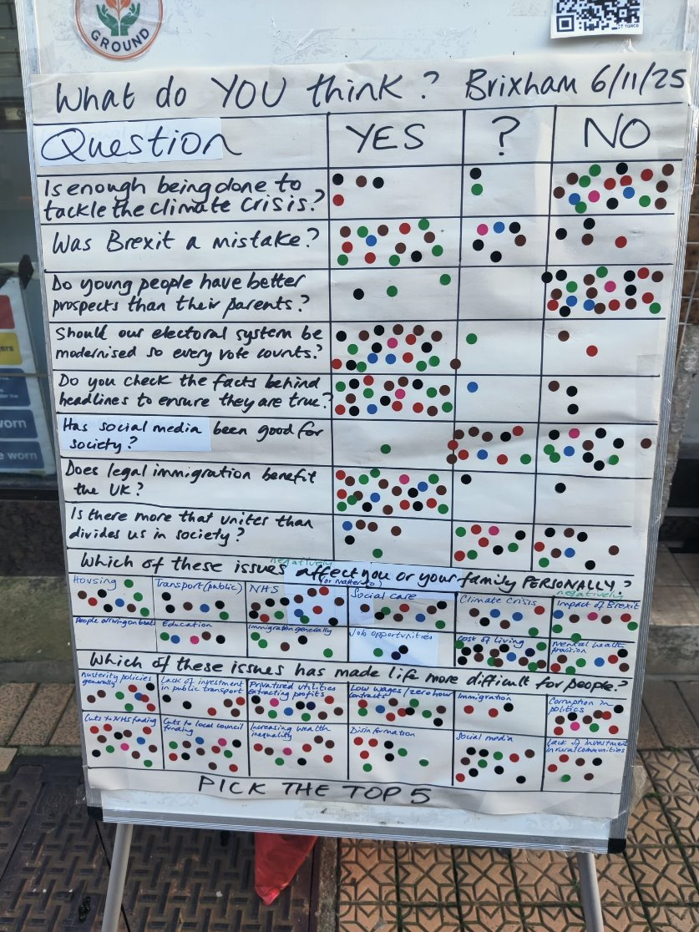
We give a lot of
thought to what we are trying to address.​ For
example, on immigration via small boats: Zero in the “affects me personally” box​.

Slide 6

The anti-Reform board we’re trialling:
Should private treatment vouchers and tax breaks for individuals' private health insurance be funded out of the NHS budget?
Do you favour an energy policy that emphasises cheaper renewables rather than fossil fuels?
Do you support the protection of women's employment and reproductive rights?
Are you in favour of bringing water and other utilities back into public ownership?
Does the public benefit from regulations on big business to prevent abuse/profiteering?
Would you rather the UK had a closer relationship with the US or the EU?
Subject to the answers, we give them a slip saying: Your answers suggest you disagree with Reform policies. If you do not want Reform to win power, you will need to vote for other parties. For information on the tactical vote for your area, visit www.stopreformuk.org

Slide 7
It is challenging to come up with neutral questions (or as neutral
as possible) that take a YES/?/NO answer. ​
​
Make sure you ‘stress-test’ your questions to ensure they aren’t ambiguous or require you to know stuff you don’t!
​
We have realised that sometimes people refuse to answer because they can detect our progressive agenda. That is information in itself.​
​
We now include more ‘ranking’ questions for greater audience participation​.
We ALWAYS ask, ‘Is there more that unites than divides us in society?’​

Slide 8
Ask yourself…
Do you want to inform people? Ask them ‘Did you know that…?’ ​
Do you want to correct myths? ‘Is this true or false…?’​
Do you want to know how they feel? Let them choose the issues that matter to them from a selection…and think carefully about that selection!
Do you want to recruit? Ask people specifically if they are prepared to help/act​
​
You can also do a moodometer: a central issue in a circle with sections (like a pie) labelled with different emotional responses eg. worried, happy, concerned ​
Include a QR code or website​

Slide 9
The effects of the boards are many:​
People feel listened to​
Calm, informed teams earn respect and thanks from participants​
People are relieved to find others think as they do…or ashamed that most don’t!​
People go away, pondering what they have heard/learned or even what they have​ discovered about themselves​
Some want to know more or get involved​
Some will tell other people and recommend they ‘have a go’ ​if they see us out
You will almost certainly have fun! ​
If you encounter difficult/hostile people, very politely say that you will have to agree to disagree and offer to shake their hand. Don’t let them make the space difficult for others or drain you.​

Slide 10
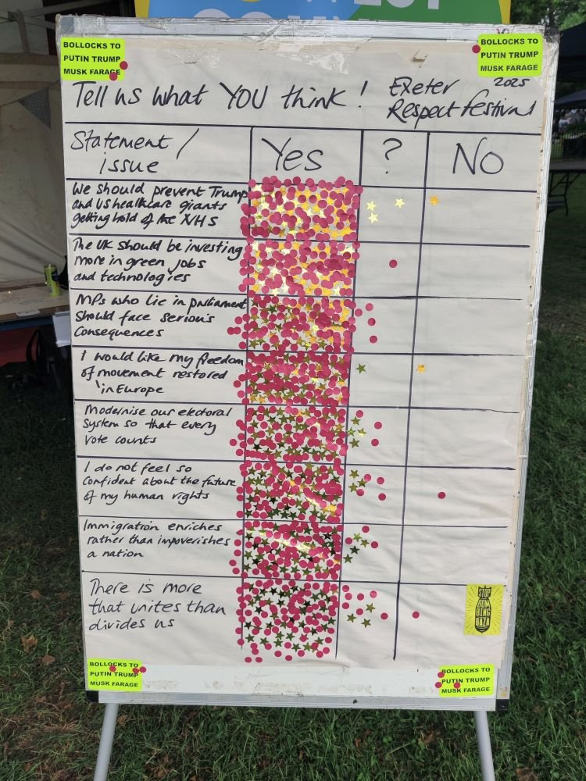
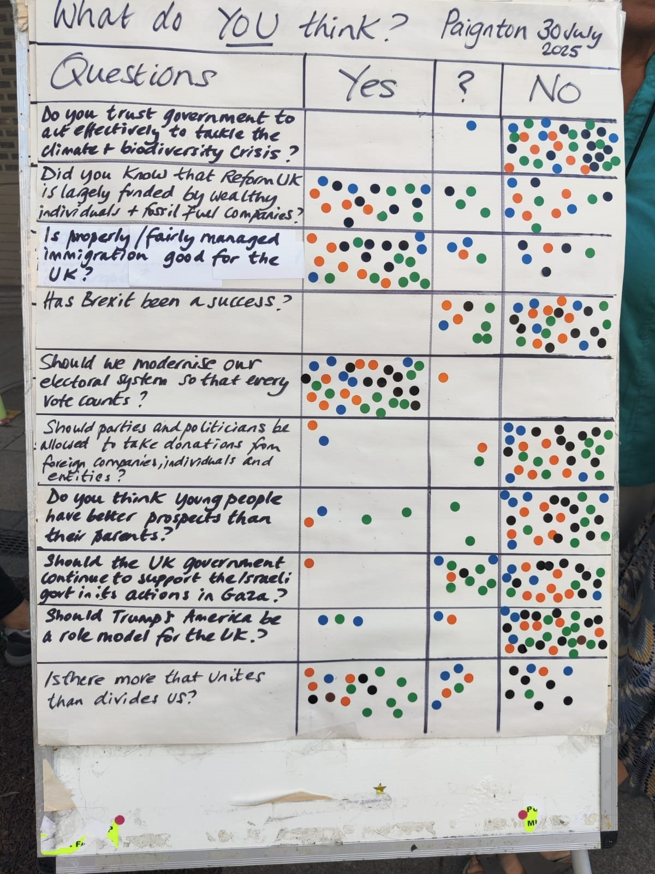
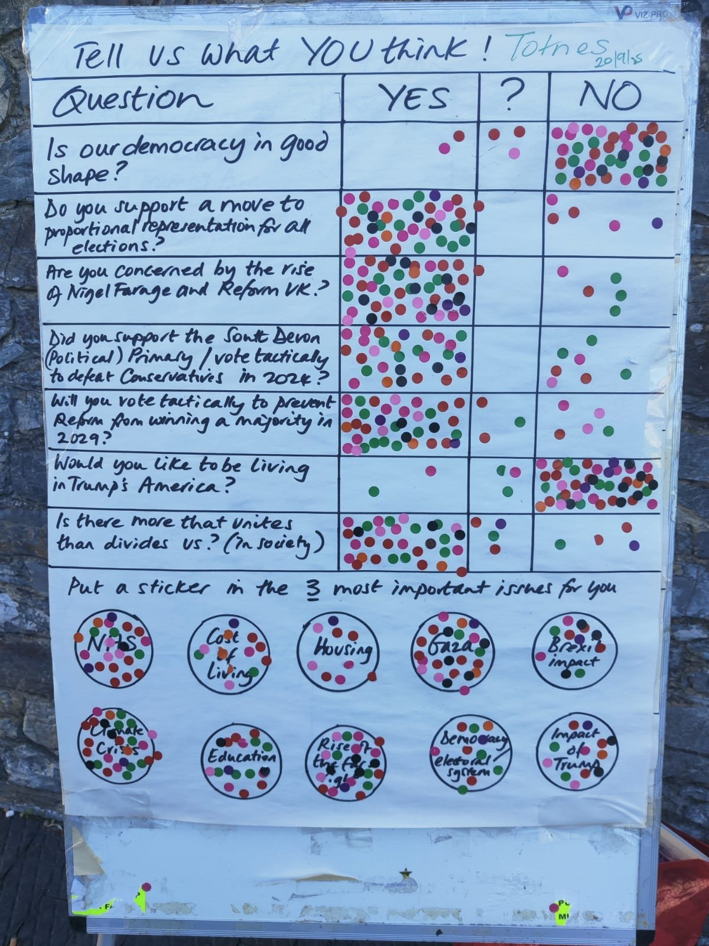
What we do with the information: ​
Share it on social media​
Share with pro-democracy movements​
Share with the local MP​
Reflect on the responses and challenge the ​effectiveness of the questions​
Evolve the board!​

Slide 11
Tips and Tricks
You need a flipchart board and paper, stickers, sharpies, a long, long ruler!​
Don’t bother on wet and very windy days!​
​Set up outside an empty shop so as not to annoy retailers.​
Shopping malls etc are problematic – private land, often. You need to be on public space.​
Don’t sell anything. Offer to put people’s stickers on for them​.
Have a QR code or sign-up cards for those who want to get involved​
90 minutes is quite long enough for one team – 3 people max​ - If you have more volunteers, run a second board.​
Thank people for taking part.​
Tell them where they can see the results​.

Slide 12

Questions!

